Slide 1
ROHITH KUMAR REDDY VANGOORU
INFO 5810 Fall 2019
Mid Term Evaluation

Slide 2
Analysis of Video game sales
Video games plays an important role in everyone’s life regardless of gender and age.
This dataset has sales data of different games along with their world rankings across different regions over past five decades (1980-2020).
The goals of this analysis are designed from the perspective of gaming manufacturers .
The results of this goals might help in taking best business decisions in order to improve customer satisfaction.
Analysis of this dataset might not only benefit publishers in understanding and improving their sales but also help gaming platforms to figure out the requirements and area of interest of customers for their future launches of new game.
Analysis is done based on several attributes like gaming genre, year published, gaming platform and geographical data of sales and other factors.

Slide 3
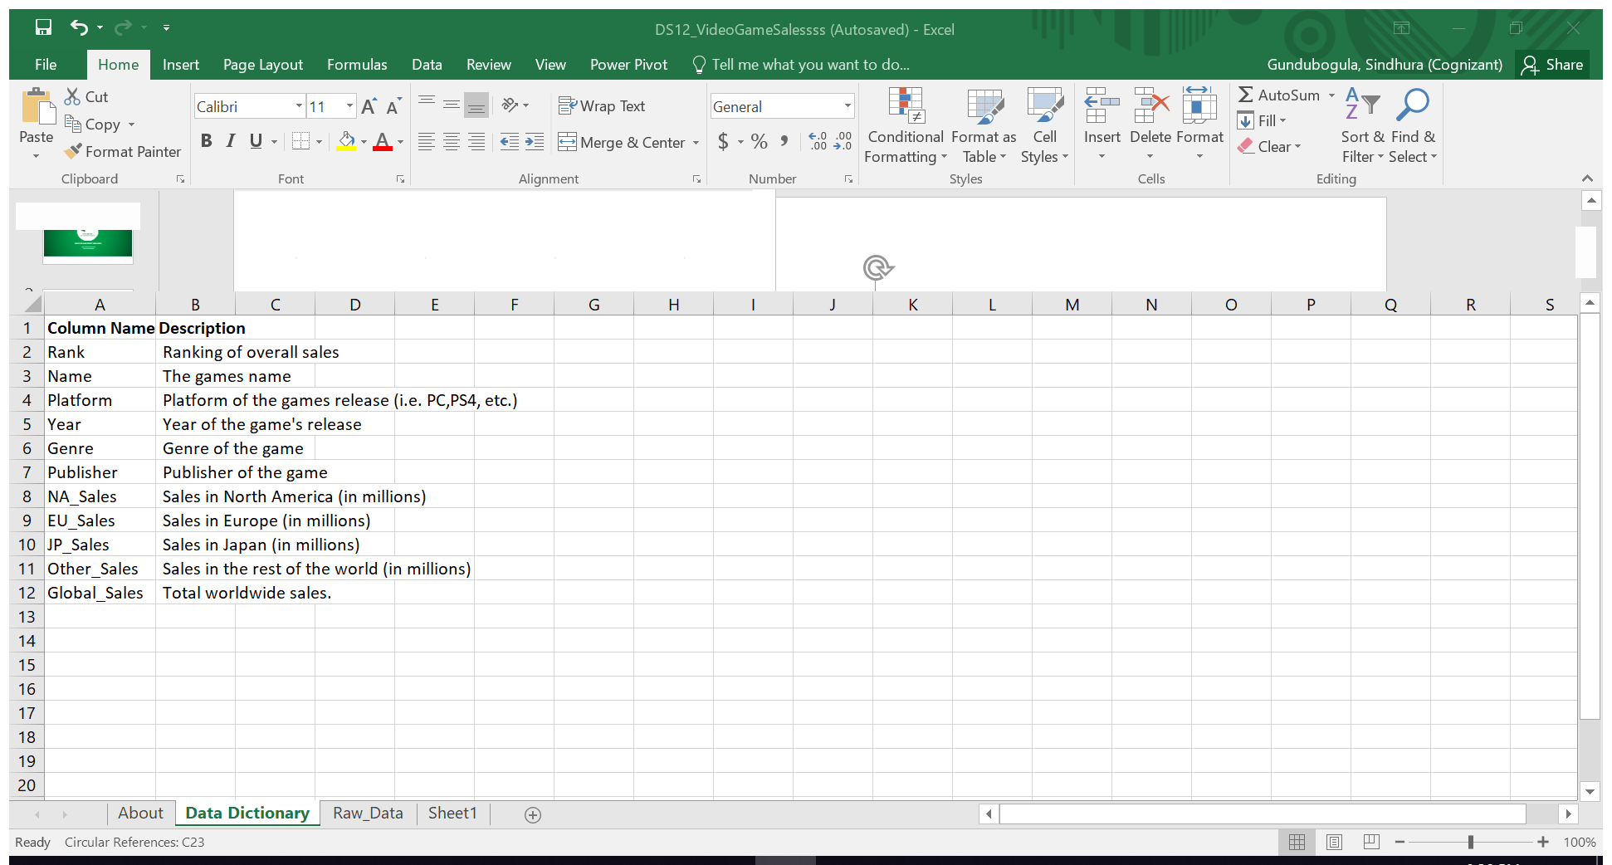
Introduction In this project we leverage the power of MSEXCEL 2016, a faster no-code way, for performing data analysis .
About the data set:
Data set was generated by scrape of vgchartz.com and consists of over 16,000 video games which were released between 1980 to 2020.This data set has 16599 rows and 11 columns.
This dataset can be downloaded from kaggle.
LINK: https://www.kaggle.com/gregorut/videogamesales
This dataset does not relate to entire gaming industry instead we can get clear understanding of the sales of video games in different regions of the world and the distribution is with respect to publishers, genres and platforms.

Slide 4
Data cleaning:
Will have to deal with very huge dataset in real life which might have certain amount of unreadable, unnecessary, inconsistent and redundant data. We can simply remove these rows if they are less than 5%. But if more than 5%, removing data might leave us with less data for our analysis. The data cleaning process can be performed by following the below steps:
Working on missing values: I encountered a plenty of missing values in the data set. So I found them by find and replace across each column. I found all n/a values and replaced them by zeros in numerical columns like sum of NA_Sales, EU_Sales, JP_Sales and Other_sales.
Inconsistent data: No data inconsistencies were found.
Removing variables based on business rules: All the variables available can be used in analysis so I didn’t remove any.
Removing variables based on Requirements: I had to add random date column to perform date functions.

Slide 5
Data analysis Approach:
I prepared few goals and performed data analysis using all the latest features of excel.
Used Excel functions like MATCH, EXP, VLOOKUP, HLOOKUP, COUNTIF, MAX, MIN, AVG, SUNTOTALS, ARRAY FORMULA and various DATE functions.
Created pivot tables and charts for interactive analysis.
Used different PIVOT charts such as column charts, pie charts, area charts, line charts etc., for visualization.
Created An Interactive Dashboard of our entire analysis using all the PIVOT charts and used few attributes as slicers.
Used data analysis add-on for obtaining descriptive statistics of an required attribute. Here I analyzed descriptive statistics of GLOBAL_SALES.

Slide 6
Data analysis:
Specific data analysis goals:
What is the rank of “Grand Theft Auto V” and “New Super Mario Bros”?
Who published “BioShock 2” and how where its sales?
What are the average global sales of “Mario Kart Wii” and “Mario Kart DS”?
What is total sales for “The incrediables”?
what is the Difference of Global_sales and NA_Sales for “The incrediables”?
Which game tops with the highest global sales?
Number of games published by “Nintendo” and “ubisoft” each
Find the exponential of global_sales of “Nintendogs “?
What were the global sales of “Wii Sports”?
How many years has passed since "Mario Kart Wii" was released?
On which day of the week did "Grand Theft Auto V" release?
On what date "Nintendogs" will be launched if is released after 456 days the actual date of launch?
To Determine the subtotals the North America Sales of Genre.
To determine the count of ps2 platform using Array formula.
Overall data analysis goals:
Analysis of sales of Gaming Platforms based on genre across all regions.
Analysis of Top 10 platforms which published maximum number of games.
Year-wise distribution of gaming platforms with high global sales.
statistics of number of games released across past five decades(1980-2020)
Trends of global sales for year 2019 quarter-wise.
Top ten years with most published games
Visualizing the characteristics, values and cumulative sum
Analysis based on Descriptive statistics of Global sales.

Slide 7
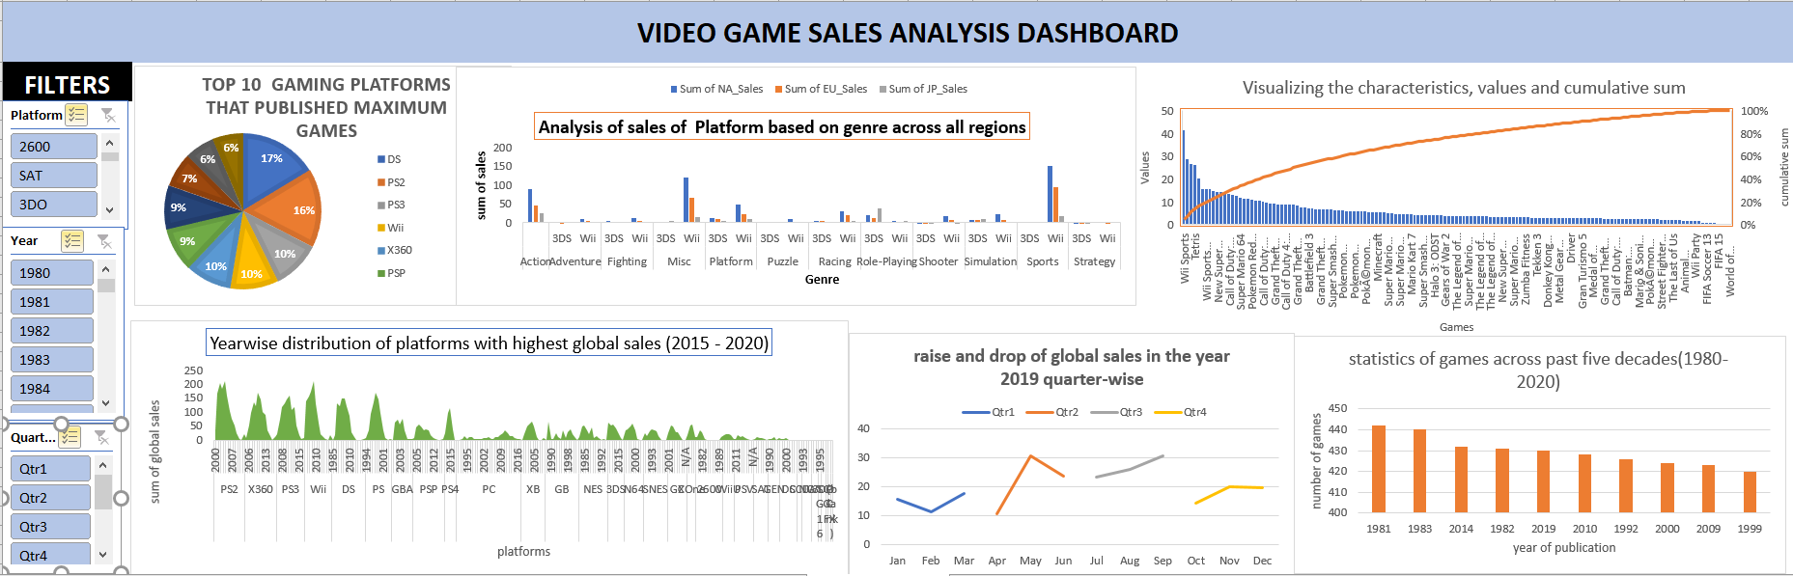
Final Dashboard :

Slide 8
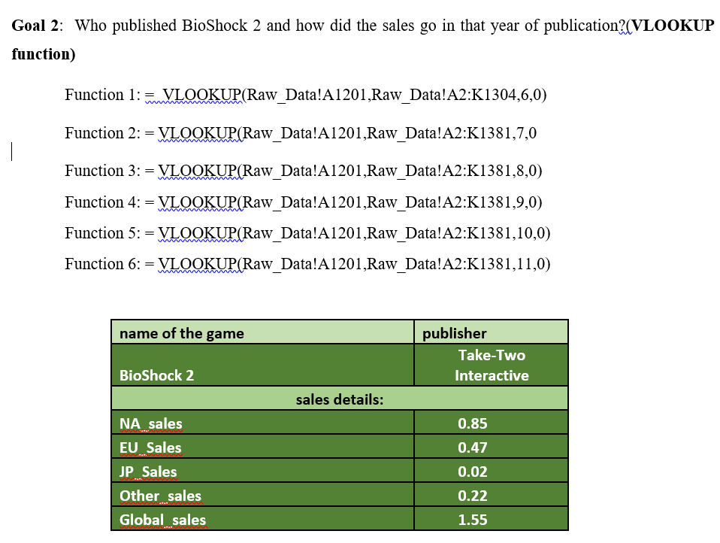
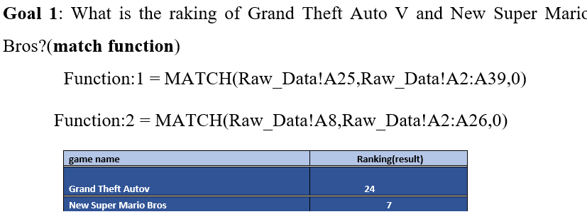
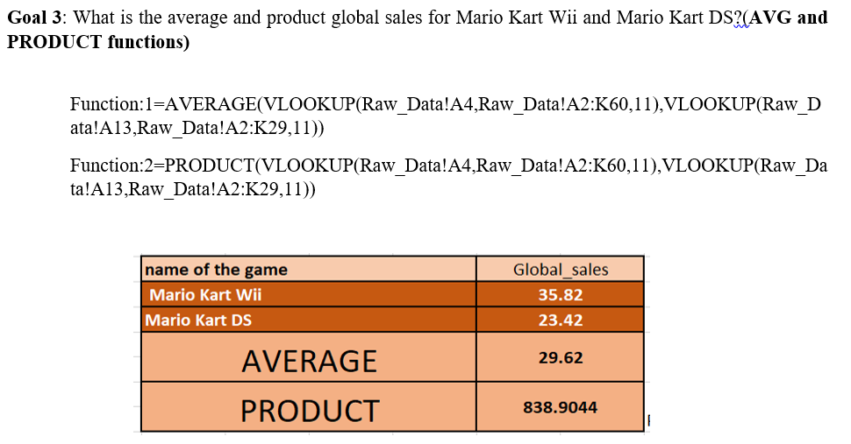
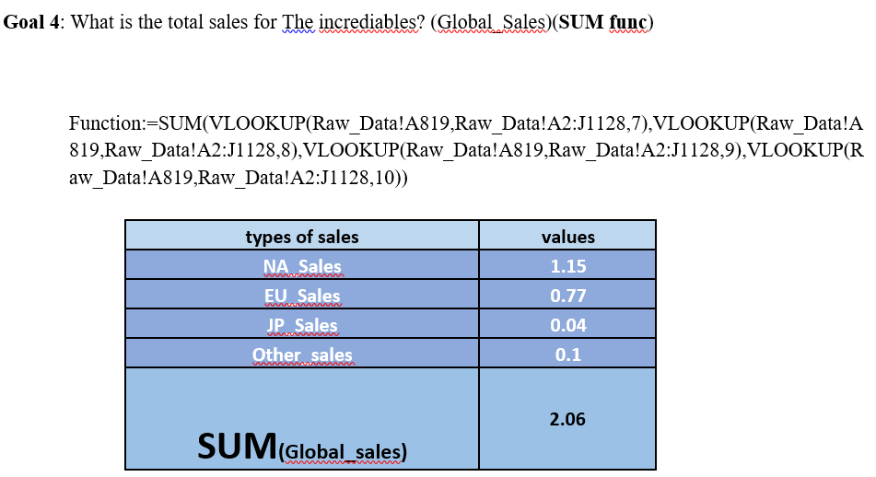
Data analysis results
Specific data goals:

Slide 9
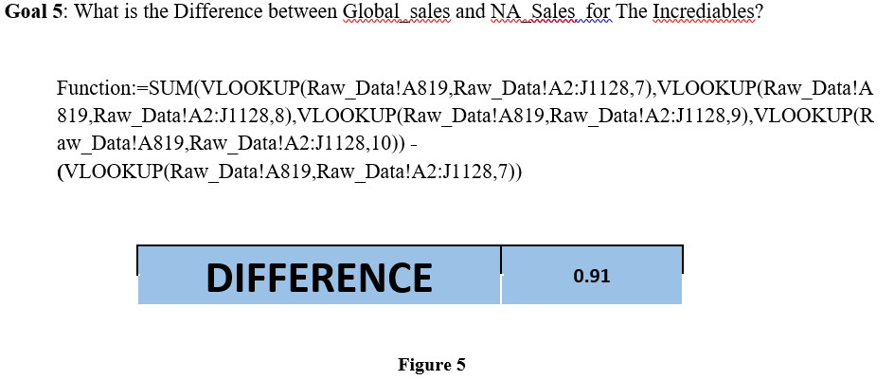
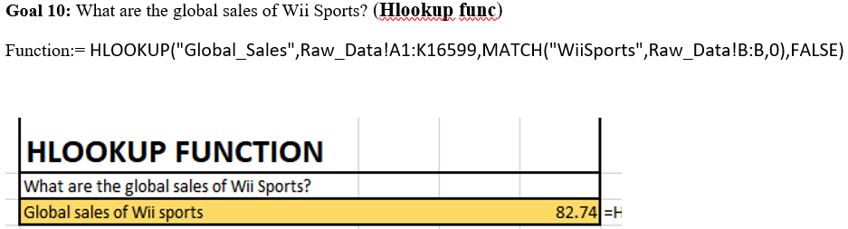
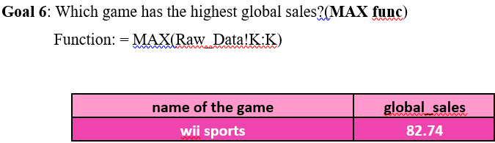
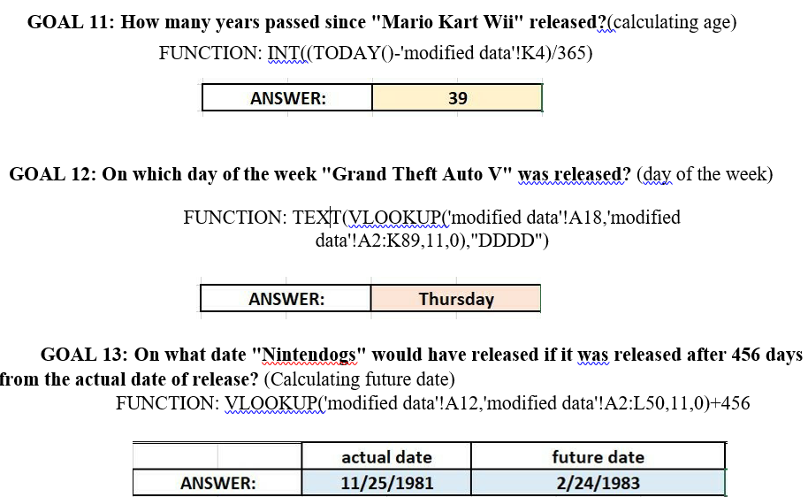
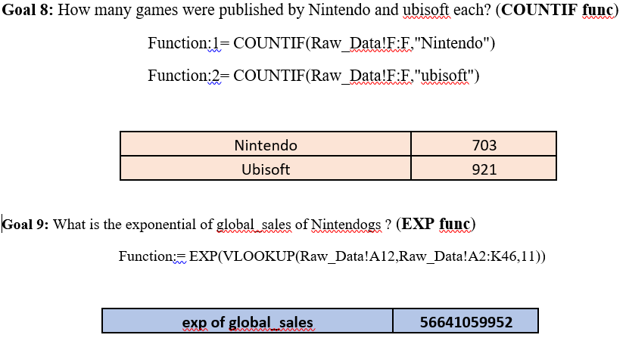
Data analysis results
Specific data goals:

Slide 10
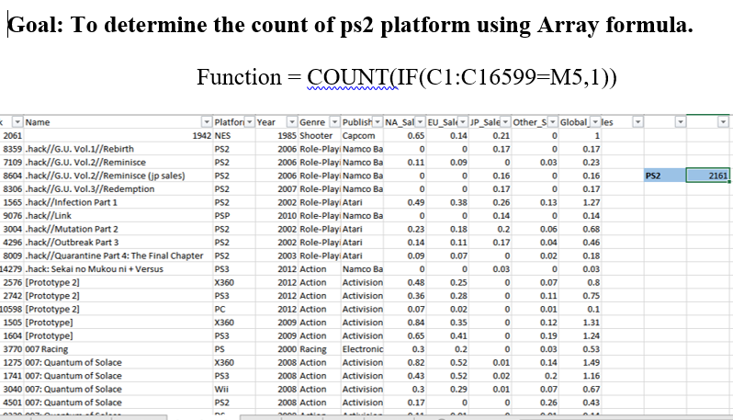
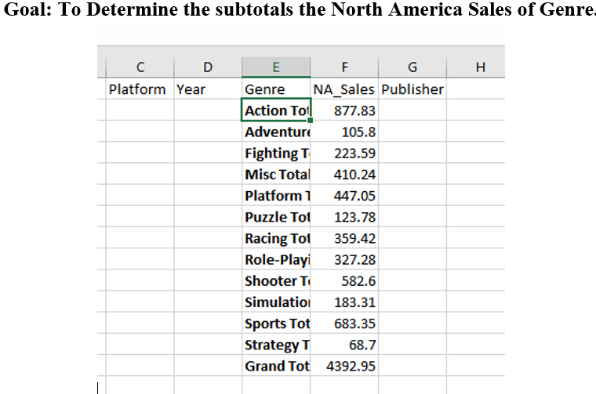
Data analysis results
Specific data analysis goals:

Slide 11
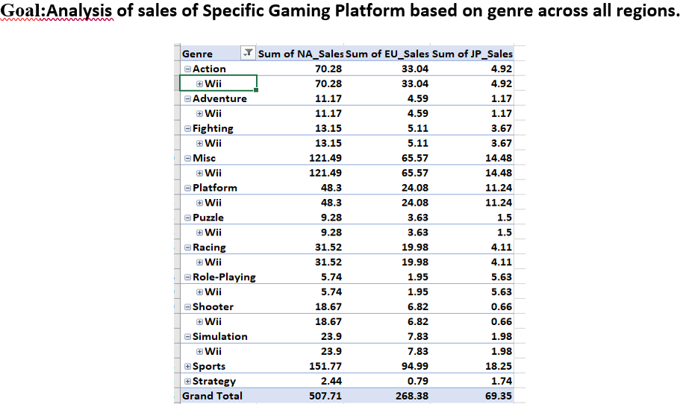
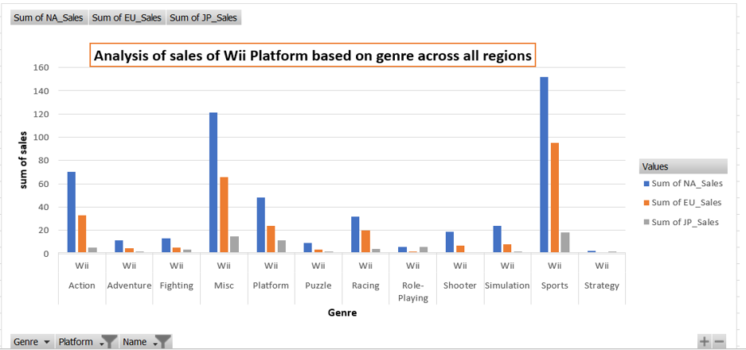
Data analysis results
Overall data analysis:

Slide 12
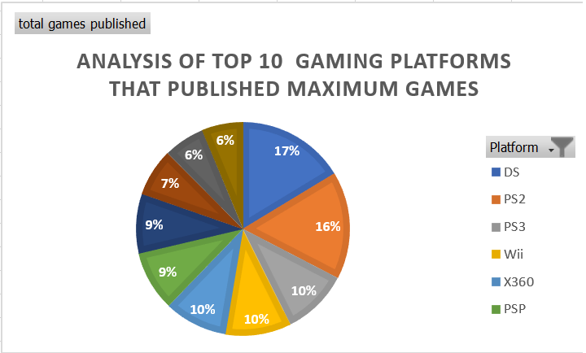
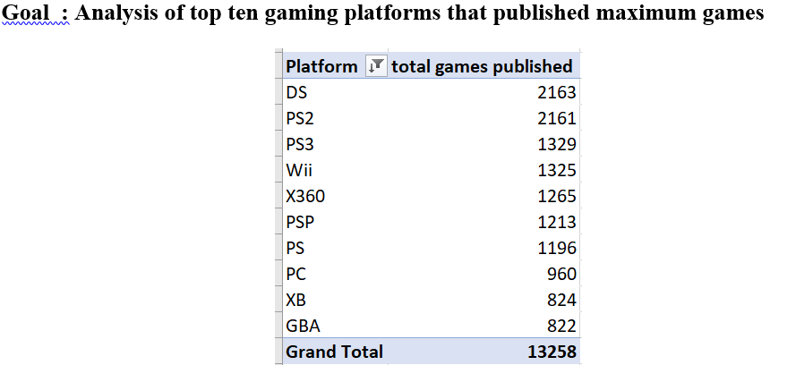
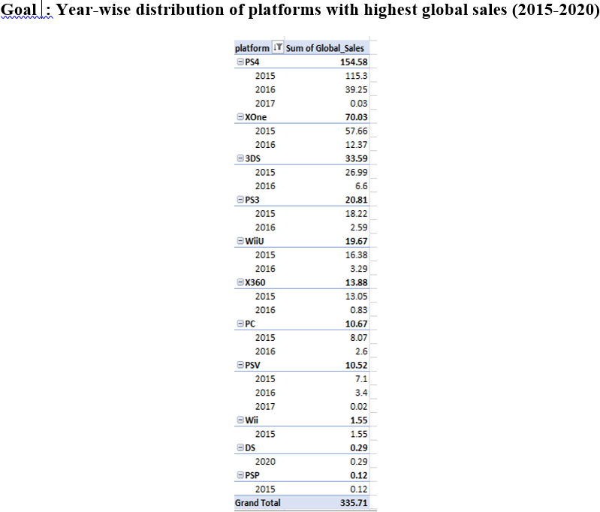
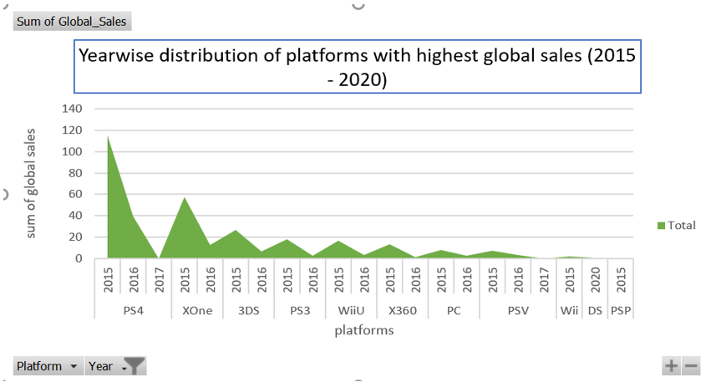
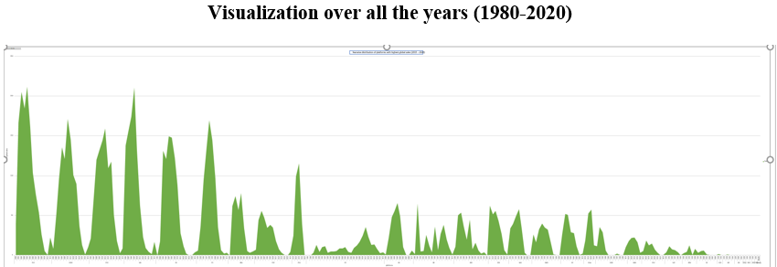
Data analysis results
Overall data analysis:

Slide 13
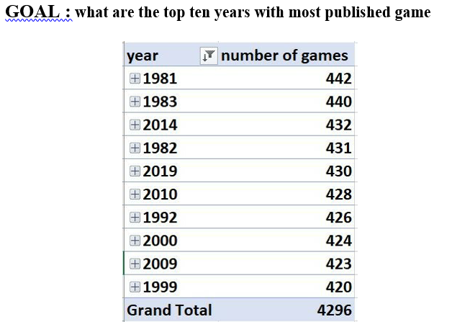
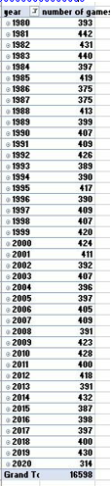
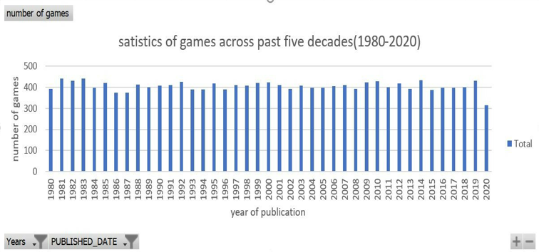
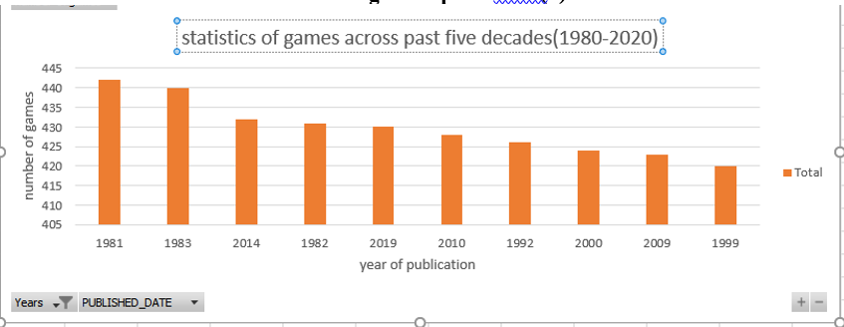
Data analysis results
Overall data analysis:

Slide 14
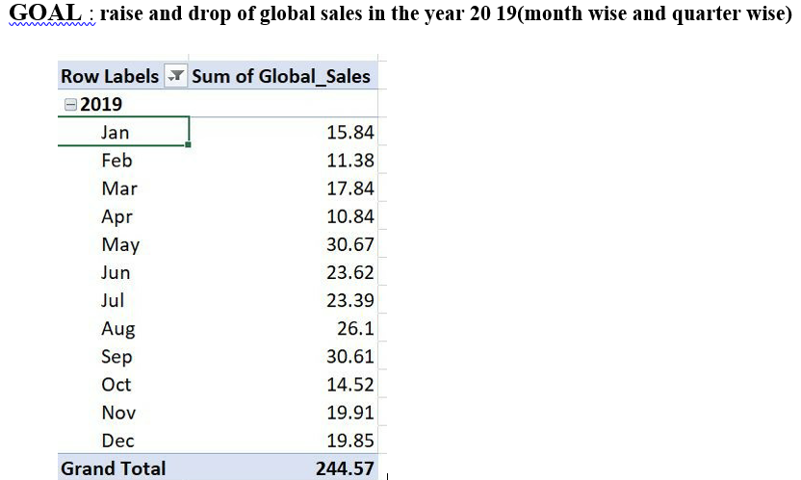
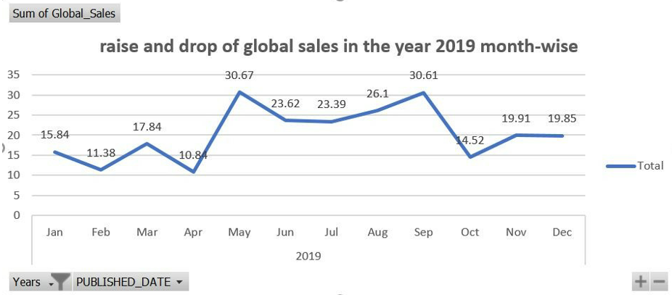
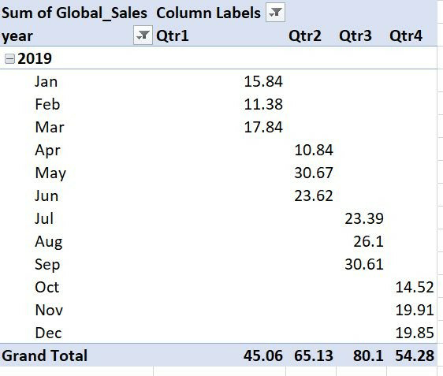
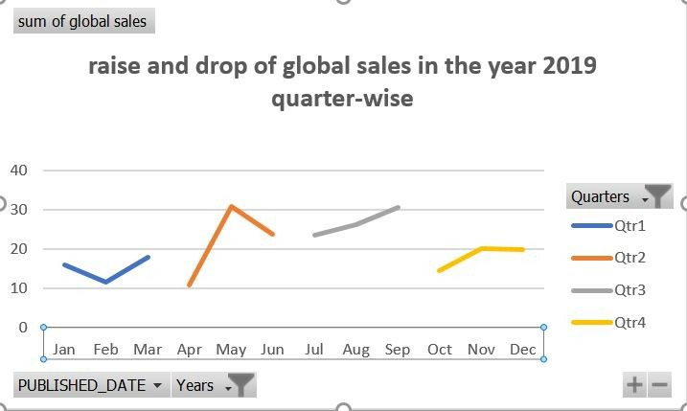
Data analysis results
Overall data analysis:

Slide 15
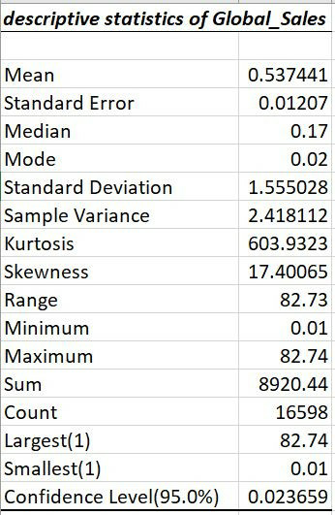
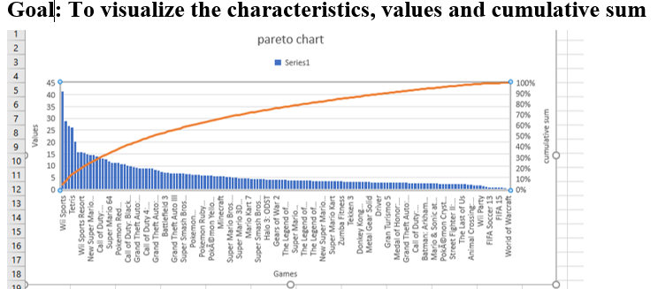
Data analysis results
Overall data analysis:

Slide 16
Conclusion
Observations:
Wii sports has the highest global sales of 82.74.
DS,PS2 and PS3 are the top 3 platforms that published most games.
1981 and 1983 were top 2 years with most number of games published.
In 2019, High sales were observed in the months of may and September i.e, in 2nd and 3rd quarter.
From descriptive statistics of global sales, we can find that average global sales as 0.53.
Organizational benefit:
By using this data analysis report, game manufacturers can find out which are type of gaming genre that attracts gamers more.
Also they can decide which time of the year is the best for launching of their future games for making high sales.
They can also stop manufacturing those games with least sales which might help them in making more profits.

Slide 17
Thank You

